Slide 1

Funnels with Warby Parker
Learn SQL from Scratch
Patrick Mohney
7/30/18

Slide 2
Funnels With Warby Parker
Get familiar with Warby Parker
What is the Quiz Funnel
A/B Testing with Home Try-On Funnel
Actionable Insights

Slide 3
1. Get Familiar with Warby Parker
What is Warby Parker?
Warby Parker is an online retailer for prescription glasses and sunglasses whose business model revolves around first narrowing down the possible styles a customer may like through a style quiz and then sending them a number of high end but affordable glasses for them to try on at home for themselves.
Once the customer has found the frames that they like best, they can prescription glasses in that style. This way they know exactly what they will get before they take the plunge.
The Tests We’ll Run
Warby Parker knows that not all users who begin their try Style Quiz will complete it, so they want to look at where the user drop of is by inspecting the Quiz Funnel.
They are also running an A/B test to see whether there is higher purchase rate between customers who receive 3 glasses to try on and those who receive 5.

Slide 4
2. What is the Quiz Funnel
Funnels General
Funnels are an illustration of the theoretical customer journey towards the purchase of a product or service.
Funnels can be used to track the progress of users as they complete the steps it takes to go from first interaction to eventual purchase.
This is valuable because you can more easily locate bottlenecks and drop offs in user progression towards final purchase
Style Quiz Funnel
Q1. What are you looking for?
Q2. What's your fit?
Q3. Which shapes
do you like?
Q4. Which colors
do you like?
Q5. When was your
last eye exam?

Slide 5
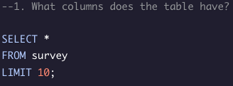
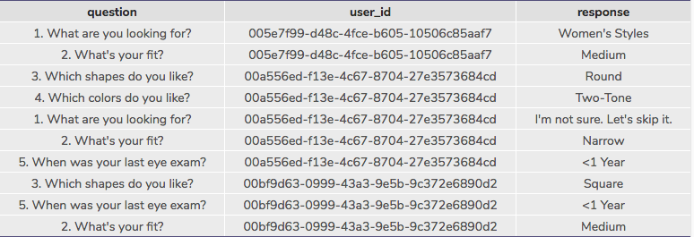
2. What is the Quiz Funnel cont’d
The three columns listed in the survey are:
question, user_id, and response.
‘question’ lists the one of the 5
questions:
“What are you looking for?"
"What's your fit?"
"Which shapes do you like?"
"Which colors do you like?"
"When was your last eye exam?"
‘user_id’ lists the unique id for each user browsing the website
‘response’ records the chosen response to the question asked in column 1

Slide 6
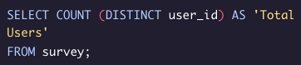
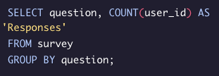
2. What is the Quiz Funnel cont’d
What’s the number of responses for each question?
First let’s look at the total number of distinct users in our survey table
Total Users
500
500. Great. Now let's look at how many responses we got for each question from these 500 users.
question | Responses
1. What are you looking for? | 500
2. What's your fit? | 475
3. Which shapes do you like? | 380
4. Which colors do you like? | 361
5. When was your last eye exam? | 270
Every user listed has answered the first question, but only a little over half (54%) of the users get through all 5 questions.

Slide 7
2. What is the Quiz Funnel cont’d
Where’s the hangup?
Question | Responses | Total % Responded | % Continued from last question
Q1. What are you looking for? | 500 | 100.00% | 100.00%
Q2. What's your fit? | 475 | 95.00% | 95.00%
Q3. Which shapes do you like? | 380 | 76.00% | 80.00%
Q4. Which colors do you like? | 361 | 72.20% | 95.00%
Q5. When was your last eye exam? | 270 | 54.00% | 74.79%
Which question(s) of the quiz have a lower completion rate?
From our graph we can see that 1 in 5 users who answered Q2 failed to answer Q3 and 1 in 4 users who answered Q4 failed to answer Q5
What do you think is the reason?
Q3 is a matter of style. The user may not have any experience with glasses or have only stuck to one style not knowing how the others would look. Possibly by having the user pick out a face shape from a set of examples and then showing how the glasses shapes and selected face shape work together they can get a better idea of their style.
Q5 is then a question of data. The user answering the quiz questions may neither remember nor have that information readily on hand at the moment.

Slide 8
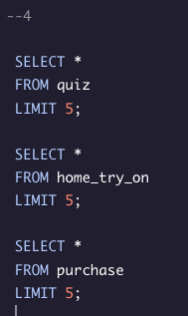
3. A/B Testing with Home Try-On Funnel
After the Style Quiz is taken, Warby Parker provides the user with a Home Try On of 3 or 5 pairs of frames.
Warby Parker is doing an A/B test to see whether there are more final purchases from people who get 3 frames or 5 frames.
For this funnel there are 3 tables we’re dealing with: quiz, home_try_on, and purchase
The Quiz table consists of the unique user_id and the answers provided to the first 4 questions
Home_try_on provides us with the user_id’s of the customers who received a home try on. It also lists their address and whether they were in the group to receive 3 frames or 5 frames
Purchase contains the user_id of those who made a final purchase, along with the product_id number, the style, model_name, color, and price.

Slide 9
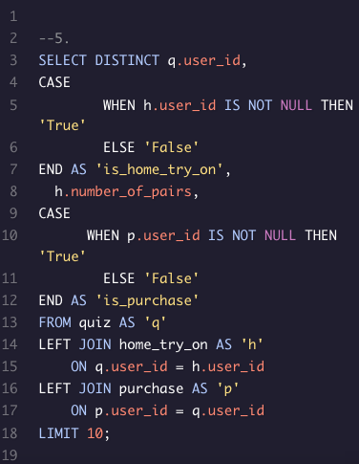
3. A/B Testing with Home Try-On Funnel cont’d
user_id | is_home_try_on | number_of_pairs | is_purchase
4e8118dc-bb3d-49bf-85fc-cca8d83232ac | True | 3 pairs | False
291f1cca-e507-48be-b063-002b14906468 | True | 3 pairs | True
75122300-0736-4087-b6d8-c0c5373a1a04 | False | Null | False
75bc6ebd-40cd-4e1d-a301-27ddd93b12e2 | True | 5 pairs | False
ce965c4d-7a2b-4db6-9847-601747fa7812 | True | 3 pairs | True
28867d12-27a6-4e6a-a5fb-8bb5440117ae | True | 5 pairs | True
5a7a7e13-fbcf-46e4-9093-79799649d6c5 | False | Null | False
0143cb8b-bb81-4916-9750-ce956c9f9bd9 | False | Null | False
a4ccc1b3-cbb6-449c-b7a5-03af42c97433 | True | 5 pairs | False
b1dded76-cd60-4222-82cb-f6d464104298 | True | 3 pairs | False
Combining the 3 tables, we get a better look at how far each user got in the process and which number of pairs they received.

Slide 10
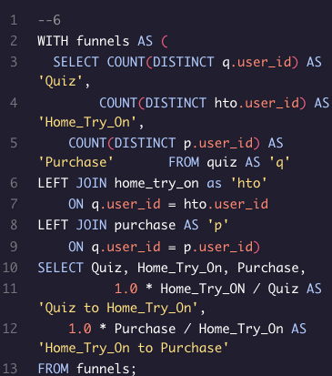
3. A/B Testing with Home Try-On Funnel cont’d
Let’s look at the overall conversion rate for each step:
Quiz | Home_Try_On | Purchase | Quiz to Home_Try_On | Home_Try_On to Purchase
1000 | 750 | 495 | 0.75 | 0.66
We can see that from the 1000 users who began the Quiz, only 750 continued to the Home Try On stage. That’s 75% or about 3 out of every 4 users.
From those 750 who moved on to the Home Try On stage, 495 ended up making a purchase. Thats 66% or about 2 out of every 3 users.
But what about the split between the 3 frame test group and the 5 frame test group?

Slide 11
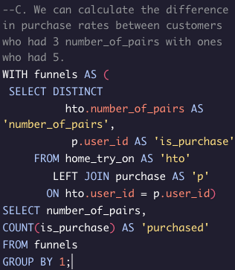
3. A/B Testing with Home Try-On Funnel cont’d
number_of_pairs | purchased
3 pairs | 201
5 pairs | 294
We can see here that the home try one experiment with 5 pairs did much better than the 3 frame experiment.
I would suggest continuing to send 5 pairs to home try on customers.

Slide 12
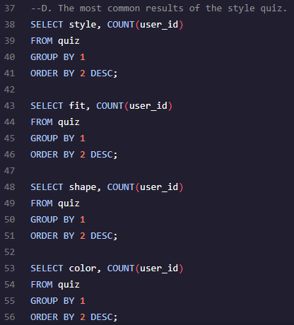
3. A/B Testing with Home Try-On Funnel cont’d
Lets take a look at the most popular results on the style quiz
style | COUNT(user_id)
Women's Styles | 469
Men's Styles | 432
I'm not sure. Let's skip it. | 99
shape | COUNT(user_id)
Rectangular | 397
Square | 326
Round | 180
No Preference | 97
fit | COUNT(user_id)
Narrow | 408
Medium | 305
Wide | 198
I'm not sure. Let's skip it. | 89
color | COUNT(user_id)
Tortoise | 292
Black | 280
Crystal | 210
Neutral | 114
Two-Tone | 104

Slide 13
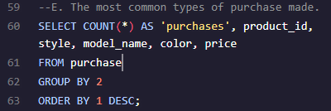
3. A/B Testing with Home Try-On Funnel cont’d
Let’s now find the most common type of
purchases made.
purchases | product_id | style | model_name | color | price
63 | 3 | Men's Styles | Dawes | Driftwood Fade | 150
62 | 10 | Women's Styles | Eugene Narrow | Rosewood Tortoise | 95
54 | 9 | Women's Styles | Eugene Narrow | Rose Crystal | 95
52 | 1 | Men's Styles | Brady | Layered Tortoise Matte | 95
50 | 6 | Women's Styles | Olive | Pearled Tortoise | 95
44 | 4 | Men's Styles | Dawes | Jet Black | 150
44 | 7 | Women's Styles | Lucy | Elderflower Crystal | 150
43 | 2 | Men's Styles | Brady | Sea Glass Gray | 95
42 | 8 | Women's Styles | Lucy | Jet Black | 150
41 | 5 | Men's Styles | Monocle | Endangered Tortoise | 50
For Men, The Dawes model has 107 (about 21% of all) sales between their two colors, although Driftwood Fade is the obvious favorite.
The Women's model Eugene Narrow takes the lead though with 116 sales which makes up a slightly larger 23% of sales

Slide 14
4. Actionable Insights
Warby Parker’s experiment was a great success. Customers who received 5 frames ended up purchasing glasses much more than those who received 3. If the person who did not like their 3 send them back to get 3 more, that’s just 1 more set of frames than those who received 5 once, but also takes time and shipping.
As suggested in an earlier slide, WP could consider using more face shape examples with different frame shapes to help people choose their preferred frame shape while working on the style quiz. They could also put a note on Q5 allowing the user to embrace the ‘I’m not sure’ part of the question for the time being, or even get rid of it as a question.
While WP should continue to find great brands for a good price, it should be noted that a number of customers (specifically male in our tests) are willing to pay extra for a nicer look as shown by the success of the Dawes model in slide 13.

